Slide 1
Chapter 8

Slide 2
Objectives

Slide 3
Objectives (continued)

Slide 4
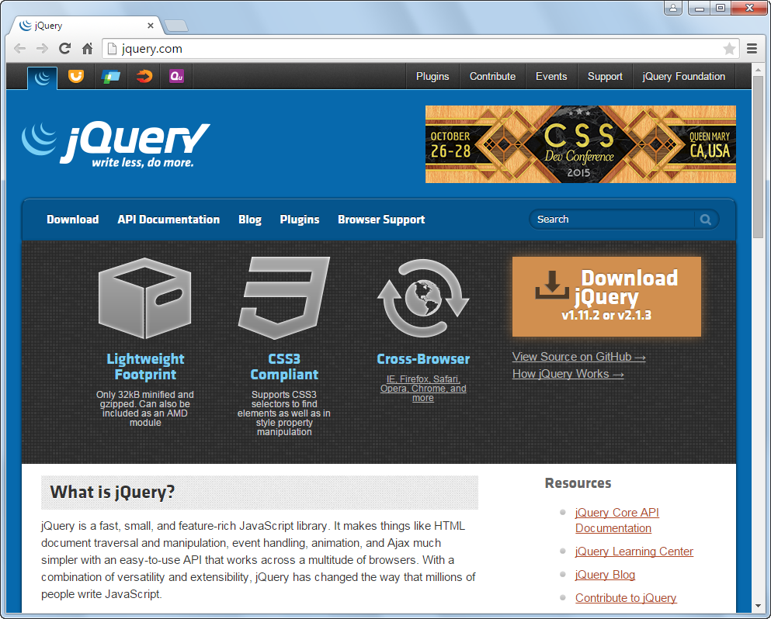
The jQuery website at www.jQuery.com

Slide 5
What jQuery offers

Slide 6
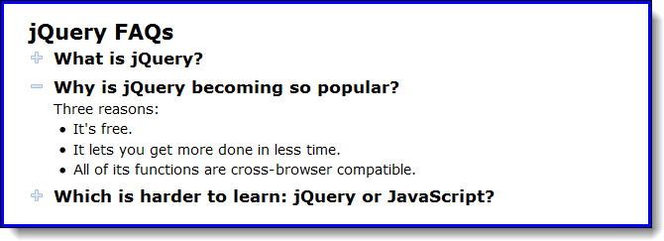
The FAQs application in a browser

Slide 7
The HTML

Slide 8
The critical CSS

Slide 9
The jQuery for the FAQs application

Slide 10
The jQuery download page

Slide 11
How to include jQuery 3.1.1 after you’ve downloaded it to your computer

Slide 12
The most important releases of jQuery

Slide 13
Two jQuery migrate plugins

Slide 14
How to include SRI checking with the jQuery CDN

Slide 15
The syntax for a jQuery selector

Slide 16
The HTML for the selected elements

Slide 17
How to select elements by element, id, and class

Slide 18
How to select elements by relationship

Slide 19
How to code multiple selectors

Slide 20
The syntax for calling a jQuery method

Slide 21
Examples that call jQuery methods

Slide 22
The syntax for a jQuery event method

Slide 23
How to code an event handler for the ready event

Slide 24
An event handler for the click event of all h2 elements

Slide 25
Terms

Slide 26
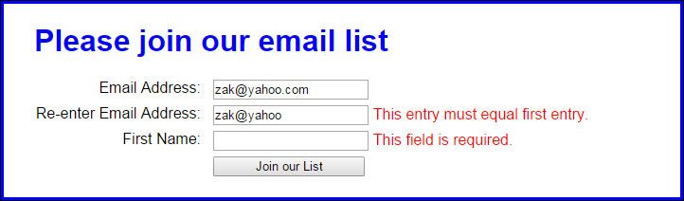
The user interface for the Email List application

Slide 27
The HTML for the Email List application

Slide 28
The HTML (continued)

Slide 29
The jQuery for the Email List application

Slide 30
The jQuery (continued)

Slide 31
Some of the most useful jQuery selectors

Slide 32
Examples that use jQuery selectors

Slide 33
Some of the most useful jQuery methods

Slide 34
Examples that use jQuery methods

Slide 35
Examples that use jQuery methods (continued)

Slide 36
Some of the most useful jQuery event methods

Slide 37
Examples that use jQuery event methods

Slide 38
A preventDefault method that stops the default action of an event

Slide 39
Other event methods that you should be aware of

Slide 40
How to attach an event handler to an event

Slide 41
How to attach an event handler to two different events

Slide 42
How to remove an event handler from an event

Slide 43
How to trigger an event

Slide 44
The FAQs application in a browser

Slide 45
The HTML for the FAQs application

Slide 46
The critical CSS for the FAQs application

Slide 47
The jQuery for the FAQs application

Slide 48

The user interface for the Image Swap application

Slide 49
The HTML for the image swap application

Slide 50
The CSS for the li elements

Slide 51
The JavaScript for the Image Swap application

Slide 52
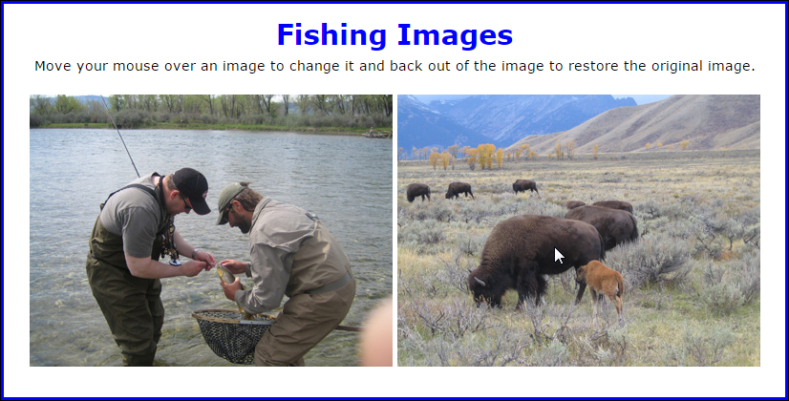
Two images with the second image rolled over

Slide 53
The HTML for the Image Rollover application

Slide 54
The JavaScript for the Image Rollover application

Slide 55
Exercise 8-3 Develop a Book List application

Slide 56
Extra 8-1 Develop an Expand/Collapse application

Slide 57
Extra 8-2 Develop an Image Gallery application

Slide 58
Short 8-1 Modify the Future Value application

Slide 59
Short 8-2 Create a FAQs Rollover application

